Slide 1


INTRODUCTION TO ANGULAR
PRESENTER: MOHAMMAD ADIL

Slide 2


Humble Request
Techno Verse YT
Heavenly Delicious

Slide 3
What is Angular?
Angular is an open-source JavaScript MVC framework for the web applications. It extends the HTML and makes it dynamic. Angular is used to create Single Page Applications.
It uses Typescript & HTML to build Apps. The Angular itself is written using the Typescript.
It now comes with every feature you need to build a complex and sophisticated web or mobile application.
It comes with features like component, Directives, Forms, Pipes, HTTP Services, Dependency Injection, etc

Slide 4
Introduction to Angular
Angular is a UI framework for building mobile and desktop web applications.
Angular is a JavaScript framework written in TypeScript and maintained by Google.
Using Angular you can build amazing client-side applications using HTML, CSS, and Typescript.
It is very important to know how the Angular framework works before you start using it.

Slide 5
Introduction to Angular
It is used for developing Single Page Applications (SPA)
It enables users to develop and test large applications easily.
It has surpassed Javascript for developing single-page applications that require modularity, testability, and developer productivity.

Slide 6
Angular Versions
First Version Of Angular called Angular JS.
Angular JS was initially released in Oct 2010.
The early version of the Angular was named as Angular 2.
Then later it was renamed to just Angular.
Angular 2 is released in September 2016.
Angular 2 is a complete rewrite from AngularJS, and written entirely in TypeScript.

Slide 7
Angular Versions
Then Angular Team releases new versions of the Angular versions Regularly and the last stable version that is available in Angular 14.1.0 / 20 July 2022.

Slide 8
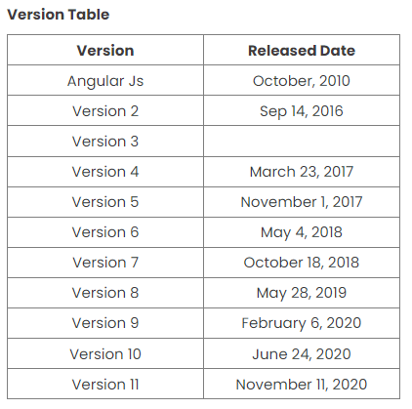

Slide 9
Angular Versions
Angular 12 release date May 12, 2021.
Angular 13 release date November 3, 2021.
Angular 14 release date 2nd June 2022.
Note: Angular release its major version after every 6 months.

Slide 10
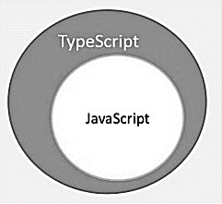
What Is TypeScript ?
TypeScript is a superset of JavaScript that compiles to plain JavaScript.
TypeScript is a strongly typed, object oriented, compiled language.

Slide 11
Features of Angular
Document Object Model (DOM)
TypeScript
Data Binding
Testing
MVC (Model View Controller)
High Speed, Ultimate Performance
Universal support
Cross Platform (Web, Mobile & Desktop)
Etc

Slide 12
Building Blocks Of Angular App
Modules
Components
Templates
Metadata
Services
Dependency Injection
Directives

Slide 13
Apps Made With Angular
Gmail App
YouTube for PS3
Weather.com
Upwork
PayPal
Forbes
Microsoft Office
Wikiwand
Delta
Netflix

Slide 14
Prerequisites
The Angular tutorial requires a working knowledge of Javascript, HTML & CSS.
It also requires the concept of OOP and web development.
We are going to use Typescript as our language.
If you have knowledge of C# or Java, then you would find it very easy.

Slide 15


